Slide 1
Natural Language Processing and
Speech Recognition

Slide 2
Distributed Representations

Slide 3

Learn advantages of distributed representation over traditional vector representations
Understand distributed representation models like Word2vec, GloVe, and FastText
Learn document vectorization model like Doc2Vec

Slide 4
Drawbacks of Fundamental Vectorization Approaches

Slide 5

Drawbacks of Basic Vectorization Approaches
Reviewing the representation schemes discussed in the last chapter, three main shortcomings emerge:
Limited semantic and contextual understanding
The basic vectorization methods such as BoWs and TF-IDF employ discrete representations.
These methods treat words as independent entities, ignoring the contextual nuances and associations.
This limits their capacity to capture the relationships between words impacting its overall understanding of the language.

Slide 6
Drawbacks of Basic Vectorization Approaches
Reviewing the representation schemes discussed in the last chapter, three main shortcomings emerge:
Computational inefficiency
The feature vectors are sparse and high-dimensional, with dimensionality growing along with the vocabulary size.
Most values in the vectors are zero, impeding learning capability and causing computational inefficiency.

Slide 7
Drawbacks of Basic Vectorization Approaches
Reviewing the representation schemes discussed in the last chapter, three main shortcomings emerge:
Inability to handle Out-Of-Vocabulary (OOV)
The basic vectorization models build representations based on the words encountered during training.
When faced with words not in the training set, the model may have difficulty creating meaningful representations.
This poses a significant challenge in understanding and processing these out-of-vocabulary words.

Slide 8
Distributed Representations

Slide 9
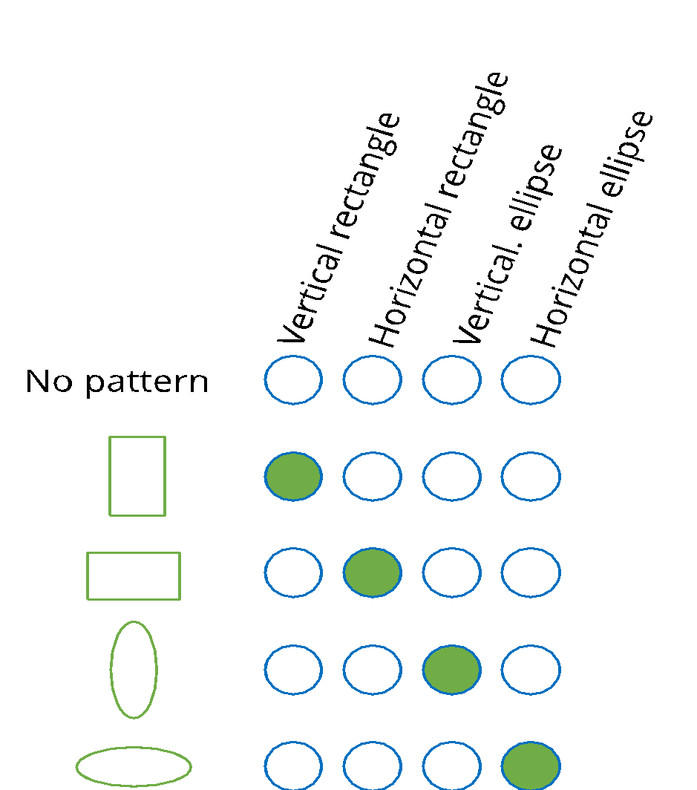
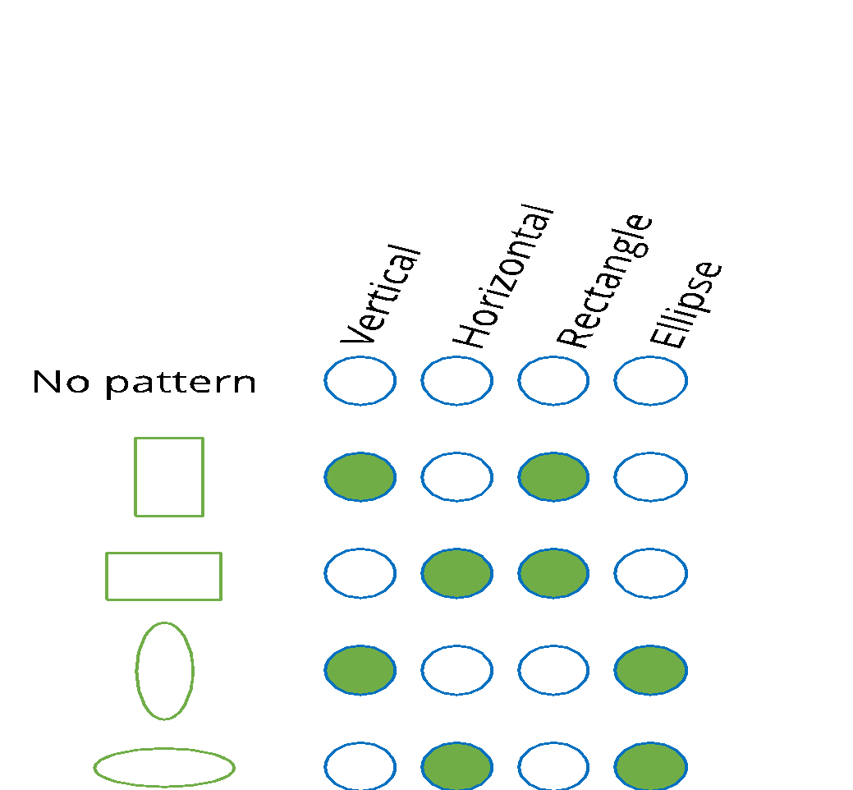
Distributed Representations
Distributed representations refer to method of representing words or entities as vectors in a multi-dimensional space.
Sparse representation
Distributed representation
They leverage neural network architectures to generate compact, low-dimensional representations for words and texts.

Slide 10
Word Embeddings
Word embedding is a technique that represents words as dense vectors in a continuous space, capturing semantic relationships and contextual meanings.
Word2Vec
FastText
Popular
word embedding generating methods
GloVe
(Global Vectors for Word Representation)

Slide 11
Word2Vec

Slide 12

Word2Vec
Word2Vec is a word embedding technique in NLP that represents words as continuous vectors in a way that captures semantic relationships based on their contextual usage
This model was developed by a team at Google, particularly Tomas Mikolov.
Word2vec is a two-layer neural network, where input is text corpus and output is set of vectors.

Slide 13
Word2Vec: Variants
Word2Vec model has two main variants:
Continuous bag-of-words (CBoWs)
Word2vec
Skip-gram

Slide 14

Continuous Bag-of-Words (CBoWs)
In CBoWs, the primary task is to build a language model that correctly predicts the center word given the context words in which the center word appears.
The | quick | brown | fox | jumps | over | the | lazy | dog
Context
Context
Focus Word

Slide 15
CBoWs: Context Size
Context size refers to the number of surrounding words taken into consideration when predicting a target word.
brown
w_{(t-2)}
Consider the example statement:
“The quick brown fox jumps over the lazy dog.”
fox
w_{(t-1)}
jumps
over
w_{(t+1)}
In this statement, the context size is 4.
w_{(t)}
the
w_{(t+2)}

Slide 16
Skip Gram Model

Slide 17
Continuous Bag-of-Words (CBoWs)
In SkipGram, the task is to predict the context words from the center word.
The | quick | brown | fox | jumps | over | the | lazy | dog
Context
Context
Focus Word

Slide 18
Skip-Gram Model
Consider the previous example statement: “The quick brown fox jumps over the lazy dog.”
the
w_{(t+2)}
over
w_{(t)}
w_{(t+1)}
fox
w_{(t-1)}
jumps
brown
w_{(t-2)}

Slide 19
Word2Vec: Pros
Word2Vec is better than basic vectorization approaches in many ways. Given below are the key advantages of using Word2Vec.
Helps to overcome the curse of dimensionality with simplicity
Pre-trained embeddings can be used in host of application
Closer physical vectors suggest closer meanings
Are self-supervised which makes it easy to get the data

Slide 20
Word2Vec: Cons
The following are a few limitations of the word2vec model.
It does not consider global co-occurrence statistics
Lack of sub-word information in morphologically rich languages
Lacks extensive awareness of broader contextual information
Words with multiple meanings may have a single representation

Slide 21
Word2Vec: Cons
These limitations are overcome by these advanced models:
It does not consider global co-occurrence statistics
Lack of sub-word information in morphologically rich languages
Solved by GloVe
Solved by FastText
Lacks extensive awareness of broader contextual information
Words with multiple meanings may have a single representation
Solved by LSTM, BERT, GPT
Solved by LSTM, BERT, GPT

Slide 22
GloVe Word Representation

Slide 23

Global Vectors for Word Representation (GloVe)
Global Vectors for Word Representation (GloVe), is a word embedding model focussing on capturing global relationships between words based on their co-occurrence probabilities in the entire corpus.
GloVe extracts the co-occurrence probability with the global statistics whereas word2vec is trained on the dataset it is made to focus on.
This makes GloVe more effective for capturing semantic relationships between words in a broader context.

Slide 24
GloVe
Let's consider an example analyzing co-occurrence probabilities of ice and steam with context words in a 6 billion token corpus.
Probabilty and ratio | k = solid | k = gas | k = water | k = fashion
P(k|ice) | 1.9 X 10⁻⁴ | 6.6 X 10⁻⁵ | 3.0 X 10⁻³ | 1.7 X 10⁻⁵
P(k|steam) | 2.2 X 10⁻⁵ | 7.8 X 10⁻⁴ | 2.2 X 10⁻³ | 1.8 X 10⁻⁵
P(k|ice)/P(k|steam) | 8.9 | 8.5 X 10⁻² | 1.36 | 0.96
Shown above is the co-occurrence matrix based on the probe words solid, gas, water, and fashion.

Slide 25
GloVe
GloVe operates on the principle that the ratio of word-word co-occurrence probability can easily determine some meaning of the words to be vectorized. In the given example:
01
The ratio mitigates noise from non-discriminative words like water and fashion
Large ratio values (>>1) align with properties specific to ice
02
03
Small ratio values (<<1) align with properties specific to steam

Slide 26
FastText

Slide 27

FastText
FastText was developed by Facebook's AI Research (FAIR) lab and is known for its efficiency, especially in handling out-of-vocabulary words and capturing subword information.
Enhanced word representation
Word vector
Sub-word vector 1
Sub-word vector 2
Sub-word vector 3
Sub-word vector 4
"fasttext"
"fast”
"astt”
"stte”
ttext

Slide 28
FastText
Some key advantages of using fastText include:
FastText embeddings are useful for languages with rich morphology
FastText can handle OOV (out of vocabulary) better than word2vec
FastText is often a first choice when you want to train custom word embeddings for your domains

Slide 29

Pre-trained word embeddings
Among the widely used pre-trained embeddings are Google's Word2Vec, Stanford's GloVe, and Facebook's fastText embeddings, among others.
Word2Vec
The popular library Gensim supports various pre-trained word embedding models and can be leveraged here.
FastText
GloVe

Slide 30
Distributed Representations Beyond Words and Characters

Slide 31
Doc2Vec
Doc2Vec captures the semantic meaning of entire documents as continuous vector representations. It was introduced by researchers at Google in 2014.
Doc2Vec shares a common architecture with the word2vec model.
Alongside word vectors, it additionally learns a paragraph vector to capture a representation for the entire text, considering words in context.

Slide 32

Doc2Vec: PV-DM
The distributed memory version of paragraph vector (PV-DM) functions as a memory, noting what's missing or representing the paragraph's topic.
Classifier
ON
Average/concatenate
Paragraph matrix
D
W
W
W
Paragraph id
the
cat
sat
Source: Distributed representations of sentences and documents Quoc V. Le, Tomas Mikolov

Slide 33
Doc2Vec: PV-DBOW
The distributed bag of words version of paragraph vector (PV-DBOW) predicts words within a paragraph based solely on the paragraph content, without taking word order into account.
Classifier
the
cat
sat
on
Paragraph matrix
D
Paragraph id
Source: Distributed representations of sentences and documents Quoc V. Le, Tomas Mikolov

Slide 34
Basic vectorization approaches have several limitations hence are not very efficient.
Distributed representation leverage neural network architectures to generate compact, low-dimensional representations for words and texts.
Few of the popular methods for generating word embeddings include Wrod2Vec, FastText, and GloVe..
The popular library Gensim supports various pre-trained word embedding models and can be leveraged here.

Slide 36
Which popular word embedding model is known for its ability to capture distributed representations efficiently?
1
Bag-of-words
Word2Vec
One-hot-encoding
TF-IDF

Slide 37
Which popular word embedding model is known for its ability to capture distributed representations efficiently?
1
Bag-of-words
Word2Vec
One-hot-encoding
TF-IDF
B
Word2Vec represents words as dense vectors in a continuous vector space, allowing it to capture semantic relationships and similarities between words based on their context.

Slide 38
How does GloVe model the relationships between words in vector space?
2
By capturing word frequency
By utilizing recurrent neural networks (RNN)
By analyzing word order
Based on global word co-occurrence statistics

Slide 39
How does GloVe model the relationships between words in vector space?
2
By capturing word frequency
By utilizing recurrent neural networks (RNN)
By analyzing word order
Based on global word co-occurrence statistics
D
GloVe models the relationships between words in vector space by capturing global word co-occurrence statistics.

Slide 40
Thank You!

